Slide 1
Internal Plagiarism Detector for Student Assignments in Multiple File Formats Using Sentence Embeddings and Cosine Similarity Algorithms
John Leshan Kool
SB06/JR/MN/14072/2022
Supervisor: Dr Okemwa

Slide 2
PROBLEM STATEMENT
Diverse file formats complicate uniform plagiarism detection.
Current tools lack focus on peer-to-peer copying within submission pools.
GENERAL OBJECTIVE
To detect similarities via cosine similarity and provide detailed reports (CSV/PDF).
SPECIFIC OBJECTIVES
To convert multiple file formats (e.g., ‘.docx’, ‘.pdf’, ‘.html’) to ‘.txt’ for uniform processing.
To generate semantic embeddings using transformer models (e.g., ‘all-MiniLM-L6-V2’).
To develop a user-friendly GUI for educators.

Slide 3
JUSTIFICATION
The rise in digital submissions has increased the complexity of detecting plagiarism in assignments. Existing tools are insufficient for addressing internal plagiarism, especially in assignments submitted within a single cohort. This tool fills this gap by focusing solely on assignment submissions, enabling academic professionals to ensure fairness and maintain academic standards.
By automating the detection process and providing detailed similarity reports, the tool;
saves time,
reduces human error,
and supports academic professionals in identifying dishonest submissions more efficiently.

Slide 4
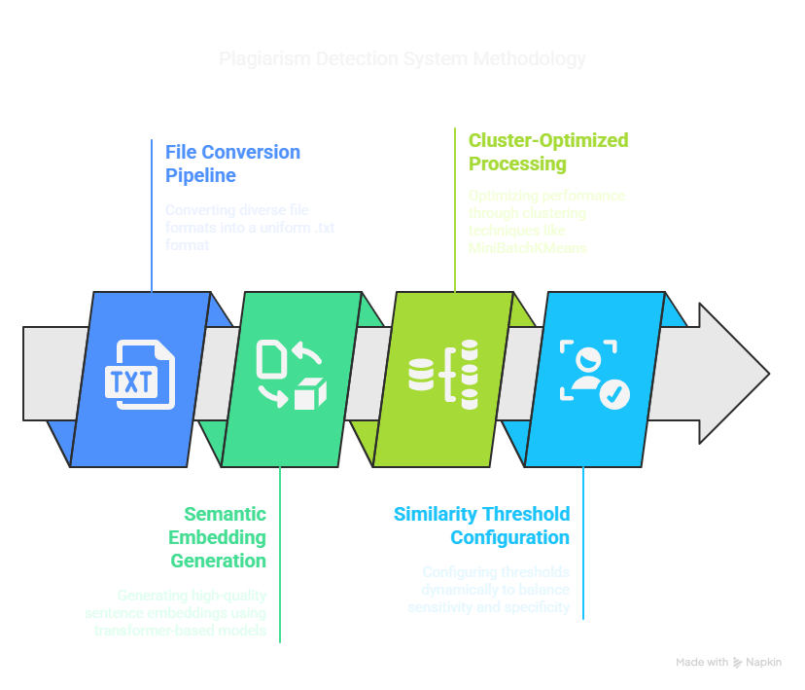

Slide 5
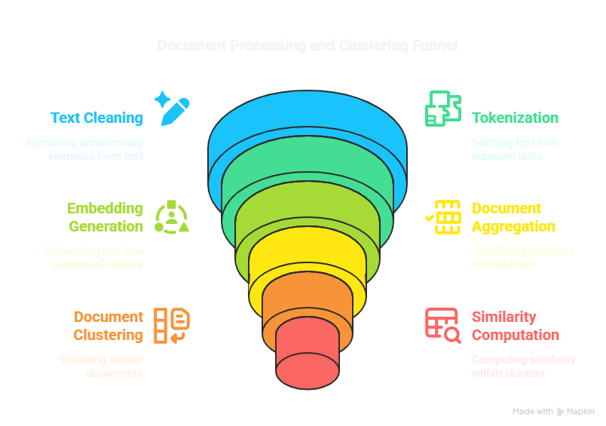

Slide 6
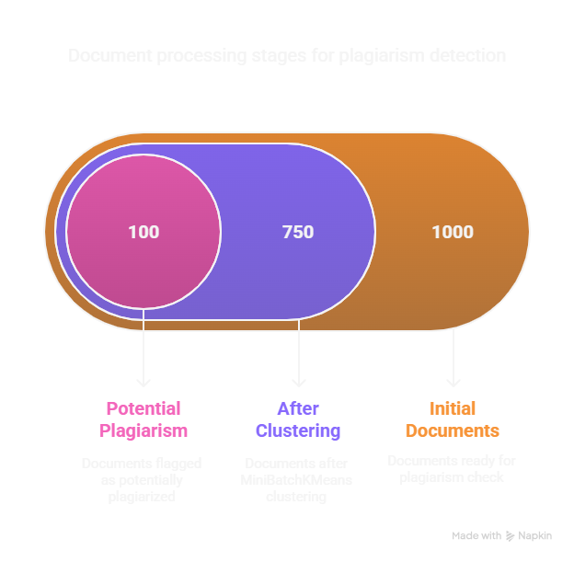

Slide 7
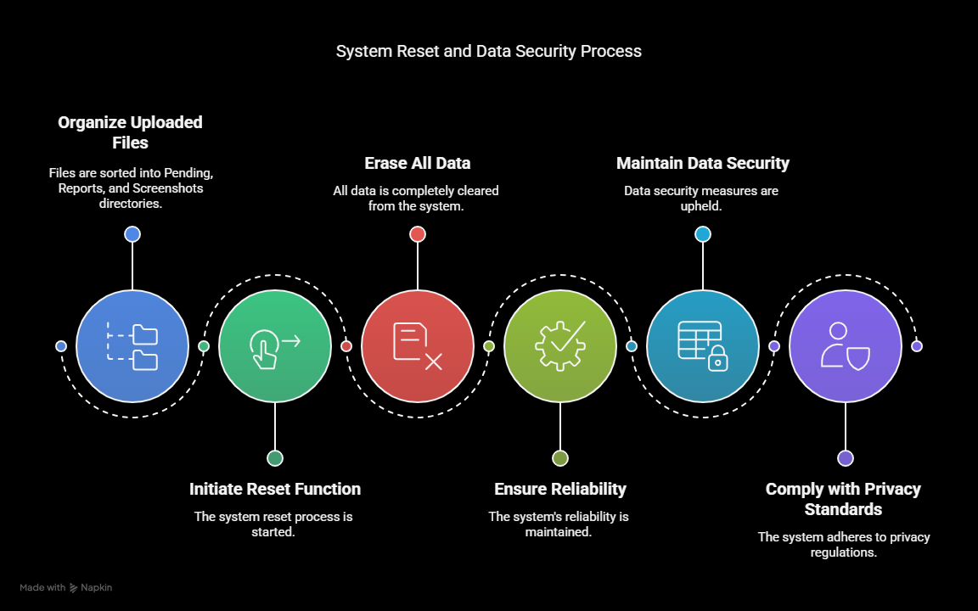

Slide 8
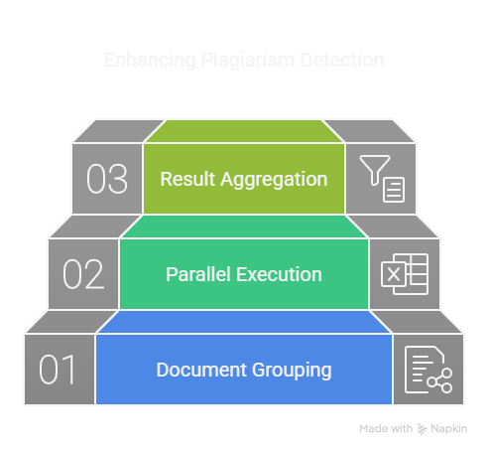

Slide 9
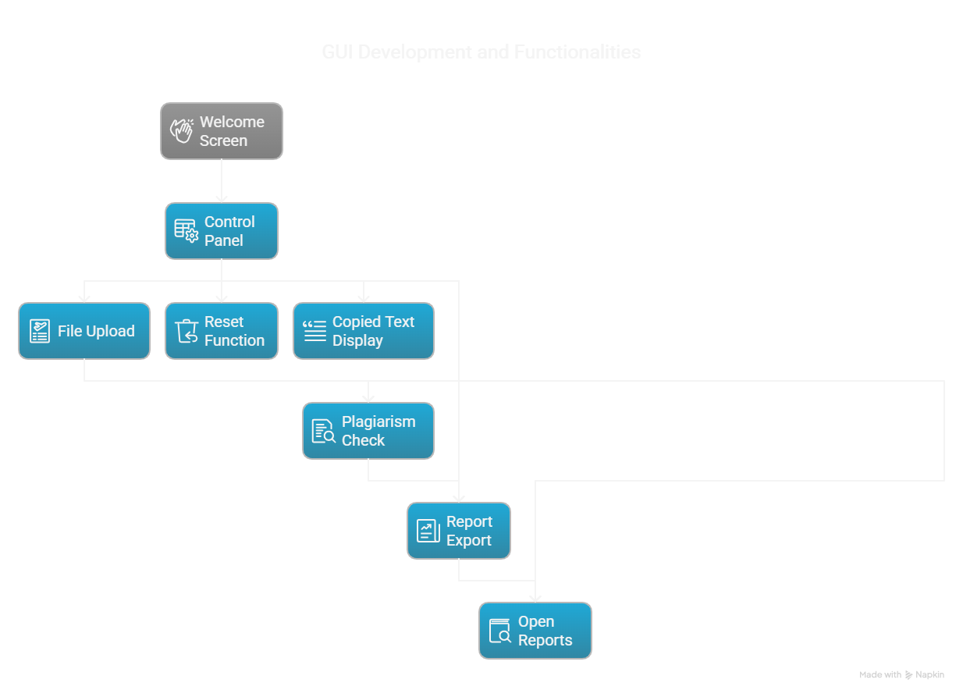

Slide 10
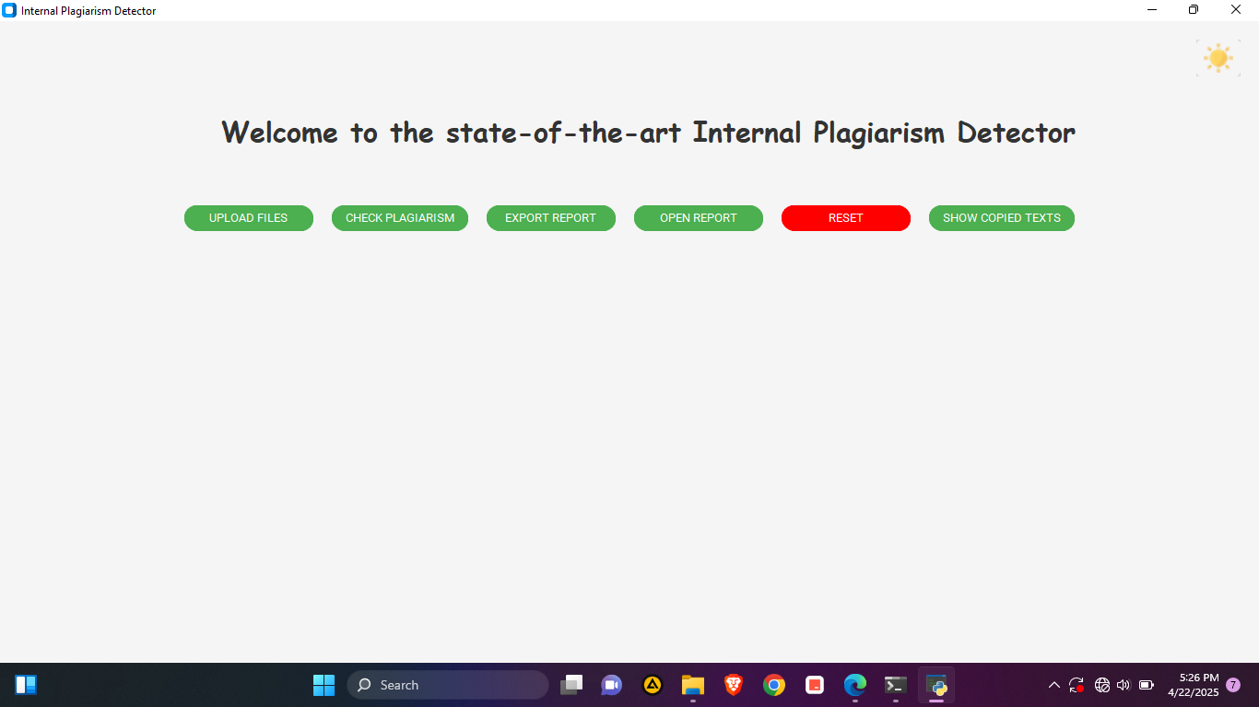

Slide 11
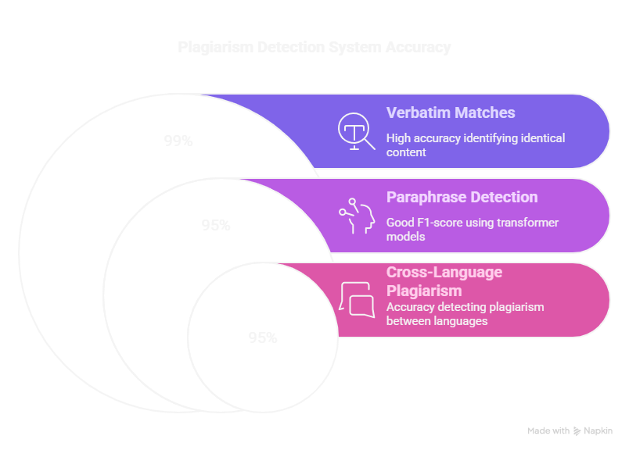

Slide 12
Challenges and Limitations
Despite advancements, several challenges persist:
False Positives: Common phrases or templates my trigger unnecessary plagiarism flags.
False Negatives: Paraphrased content can evade detection.
Computational Intensity: Advanced models require significant processing power.

Slide 13
Future Works
Support for Multiple Languages.
Expanding the system to accommodate languages such as French, Chinese, and Spanish.
Plagiarism Detection in Code Submissions.
Expanding the tool to include programming assignments would address academic integrity concerns in computer science education.
Detection of AI-Generated Content.
Given the rapid rise of AI-assisted writing, developing classifiers capable of identifying machine-generated text with high precision is crucial.

